Slide 1
models
A simple approach to complex problems

Slide 2
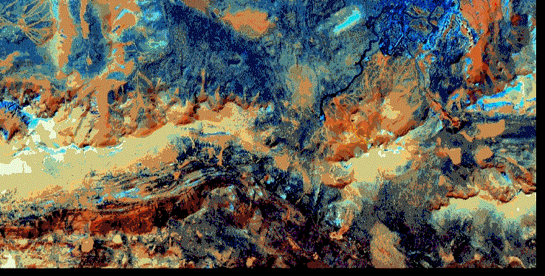
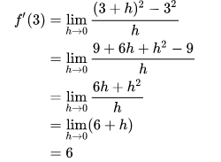
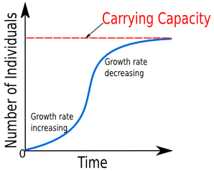
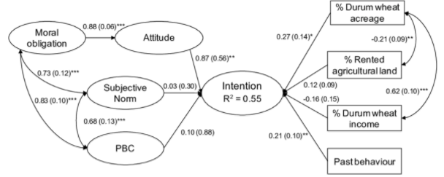
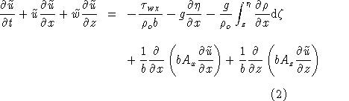
Overview
What is an “ecological model”?
Types of models & how agent-based models are different

Slide 3
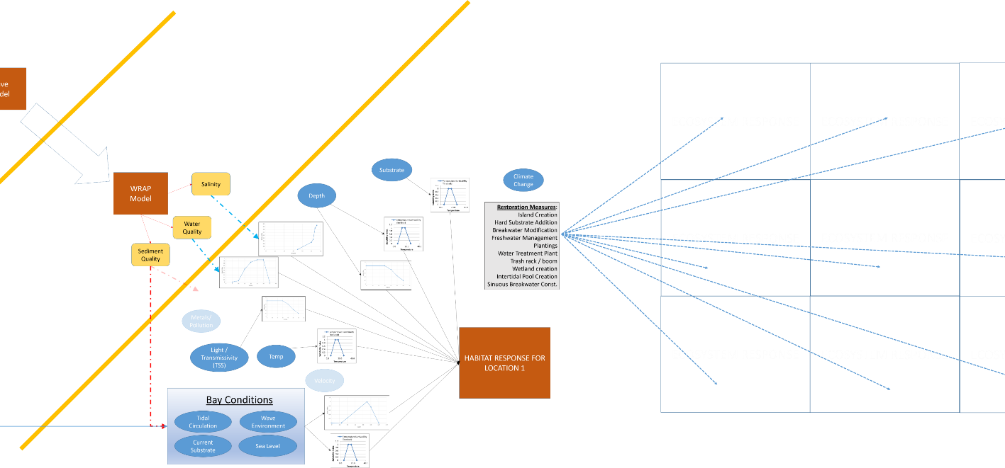
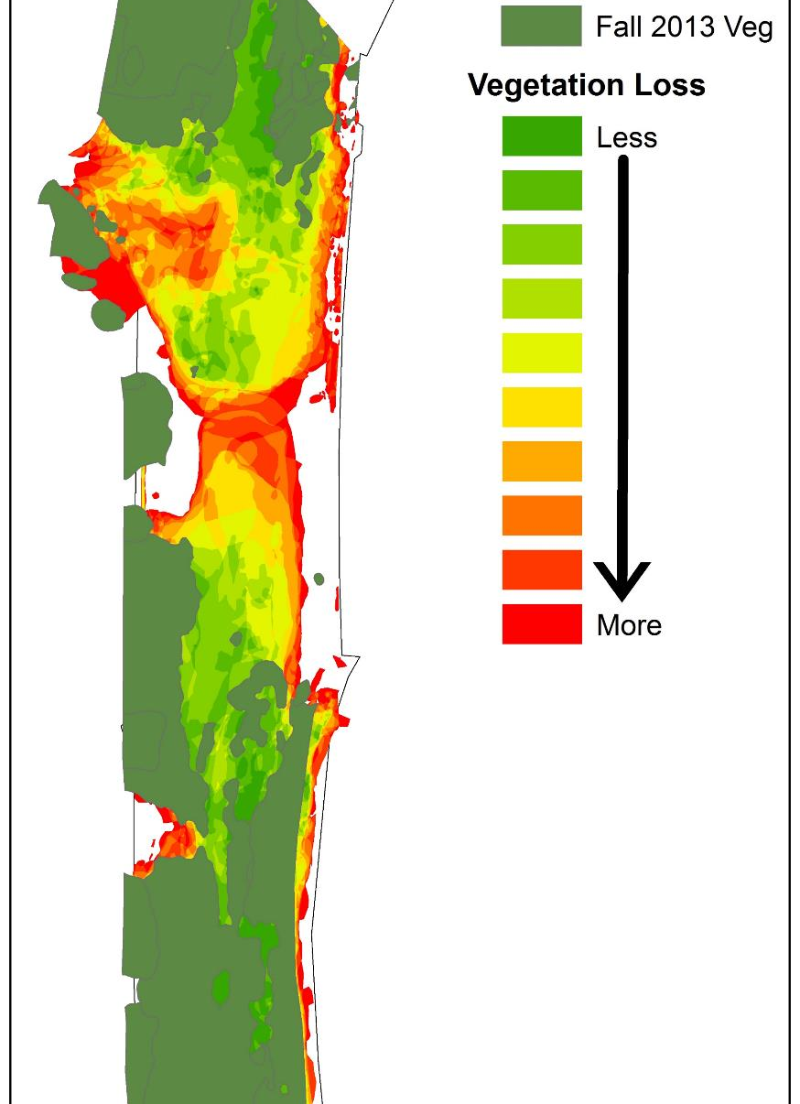
Definition of models
You are a modeler.
Commonly used in the nerd world:
“abstractions of reality”
“a representation of a system for a purpose”
“a way to represent a system for the purposes of reproducing, simplifying, analyzing, or understanding it”
How would you tell your family what a model is?

Slide 4
Definition of model for this class
Numerical representation of an ecological system implemented in software
SIDE NOTE: not software applicable to any situation

Slide 5
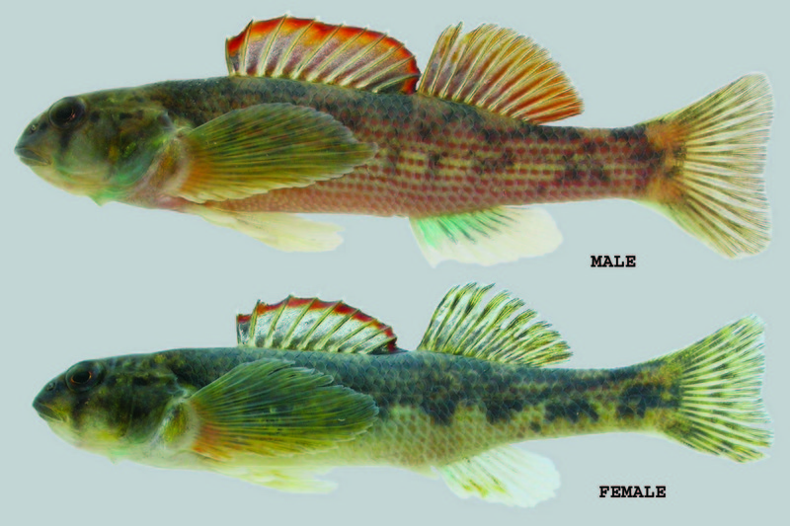
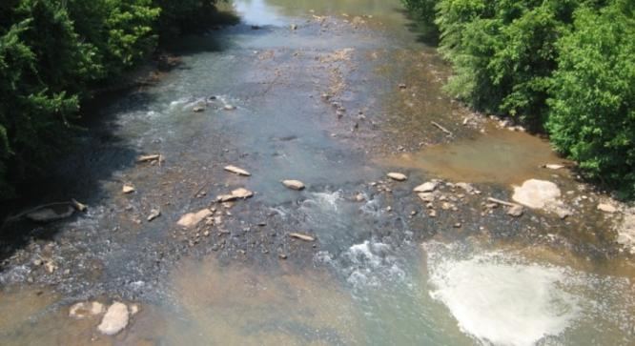
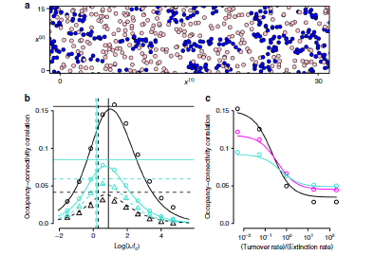
Ecological modeling
Represents environment based on point of view of model builders
Ecology is a question-driven discipline
Ecosystems are inherently complex, interdependent systems with lots of uncertainty
Models are developed to explore complexity, interactions, forecasts
Each species reacts differently to stimuli
Multiple approaches for a single problem
Habitat v. population v. meta-population v. community v. ecosystem
Different types of models can be used for same question
Trade-offs: detail, scale, expense

Slide 6
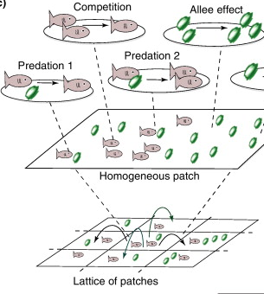
Why do we develop models?
Models!
To increase understanding & develop theory
To organize thinking
To forecast future conditions
To inform decision-making
Provide a platform for critical thinking

Slide 7
Is modeling science?
Is science modeling?
Modeling process is based on scientific method
A hypothesis is a mental/written model
Odum (1984) describes models as an important part of scientific method
Software has made it easy to ignore scientific practice
Standard techniques and documentation are important for scientific models
Iterative model
development

Slide 8
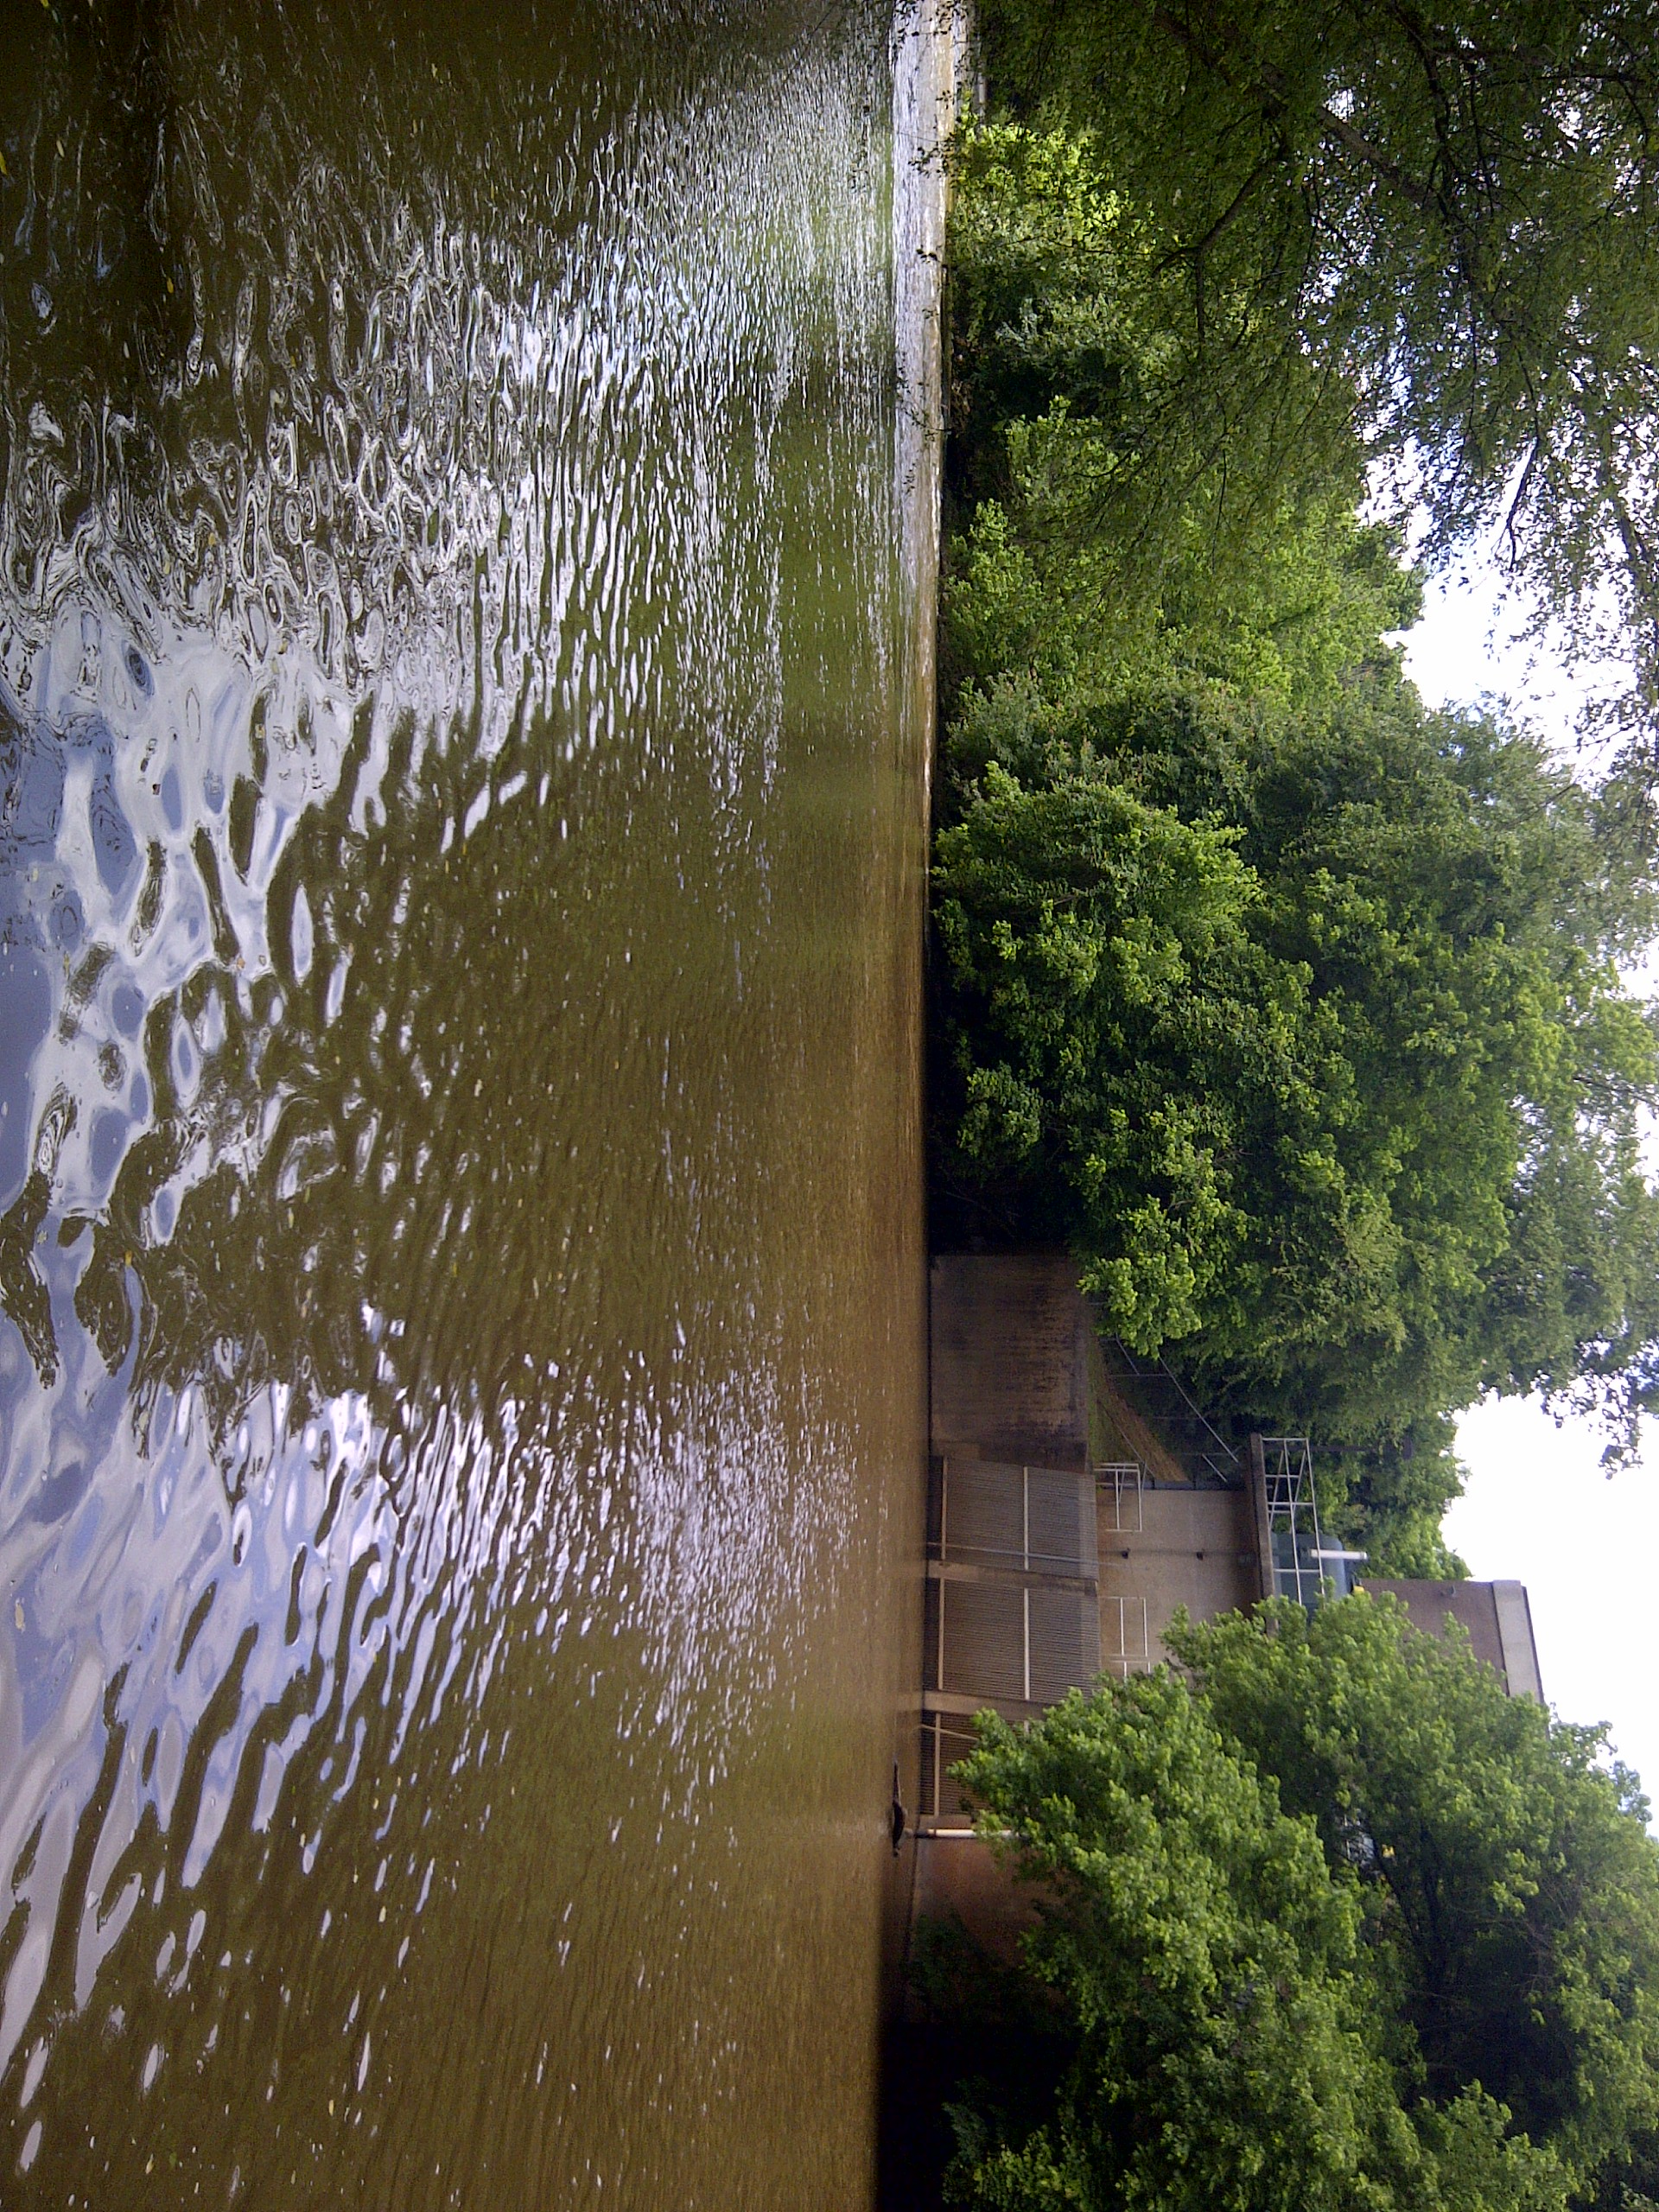
Models are never
Answers or Decisions
People make decisions. Models inform people.
Reality
Inherently a model is an abstraction of reality.
X

Slide 9
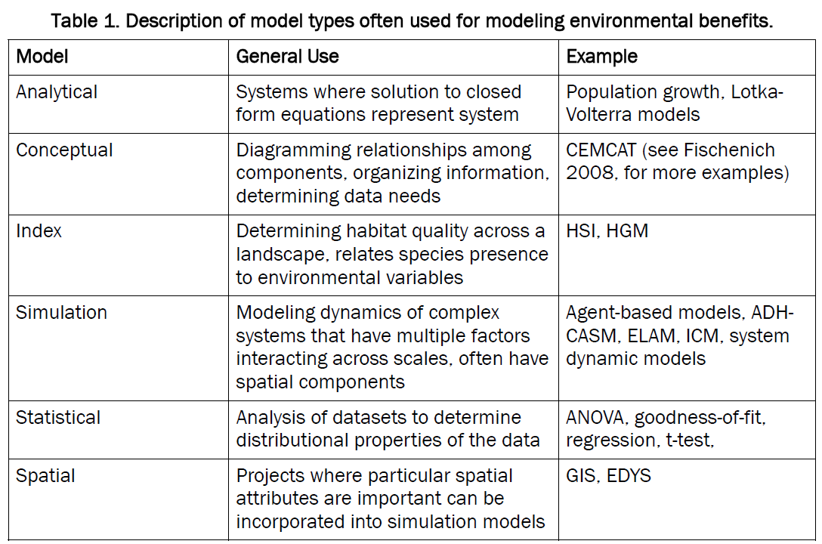

Slide 10
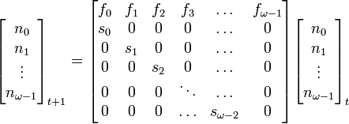
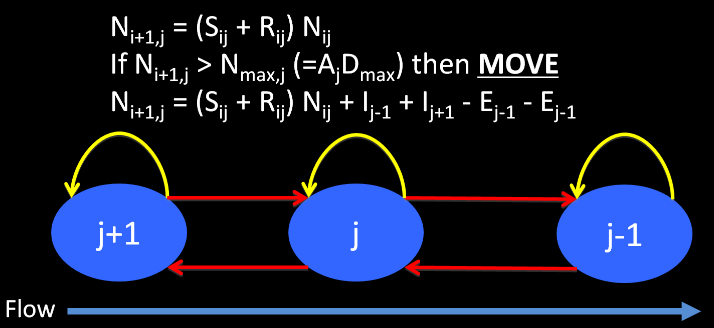
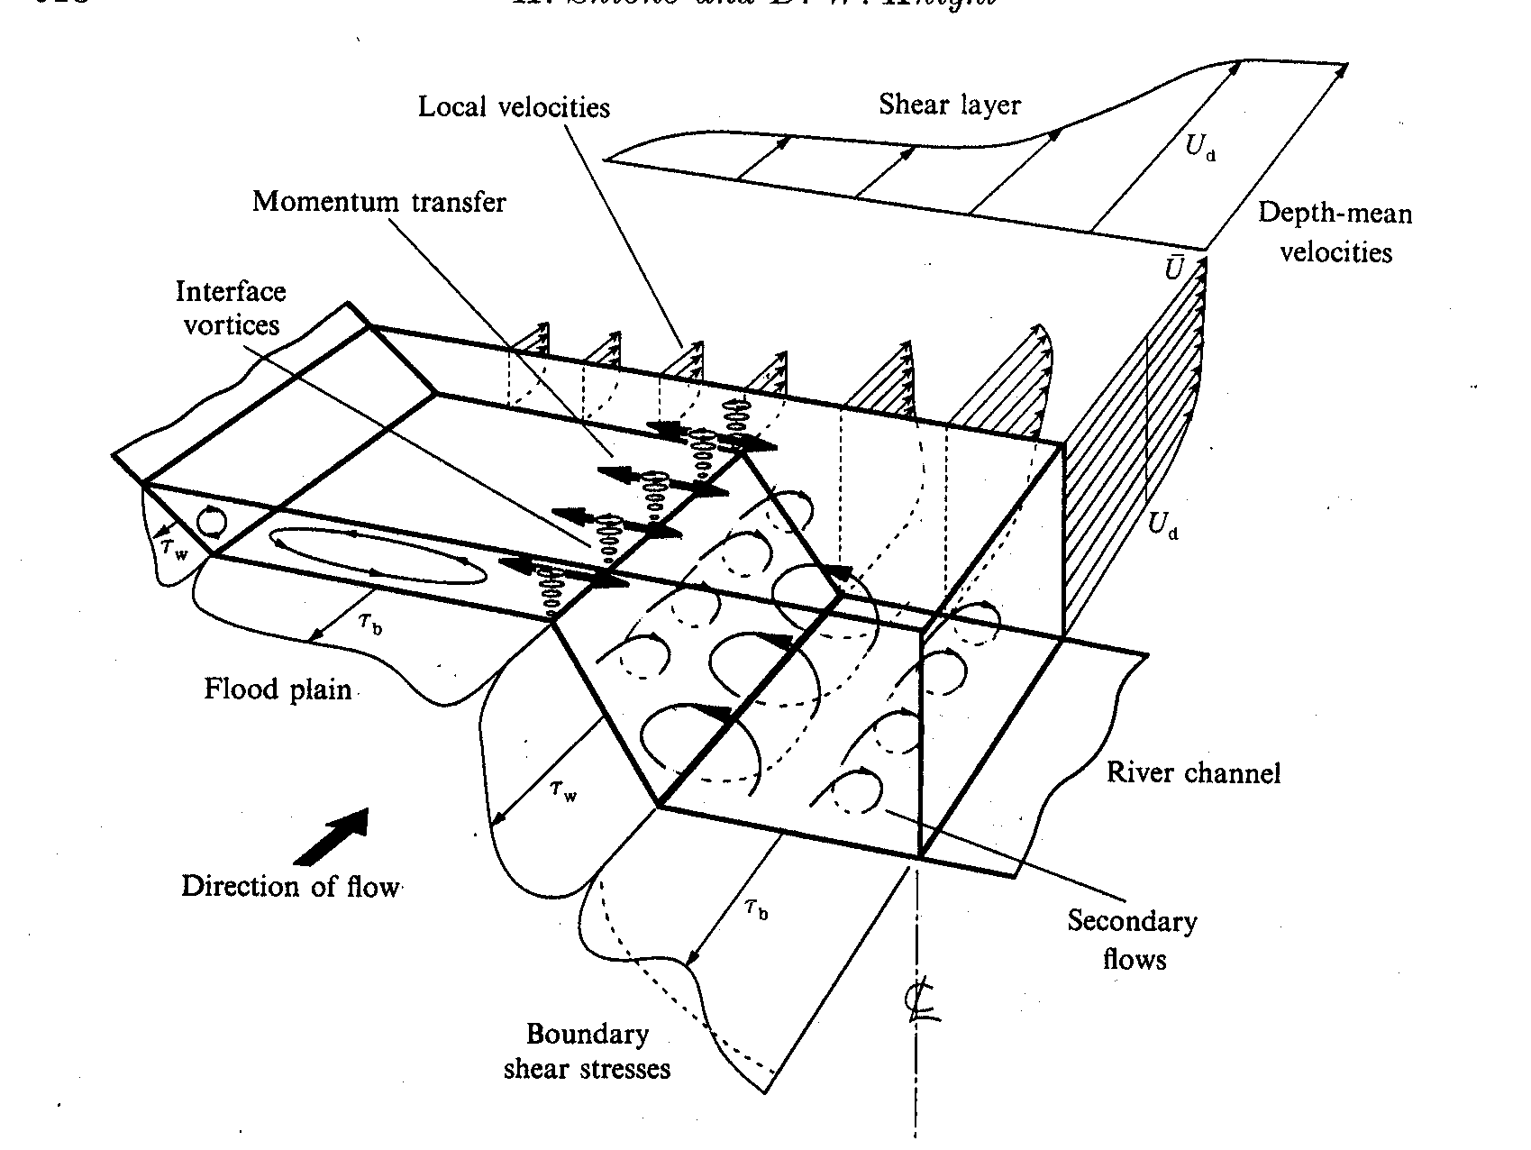
Analytical Models
Solution of closed form equations representing the system

Slide 11
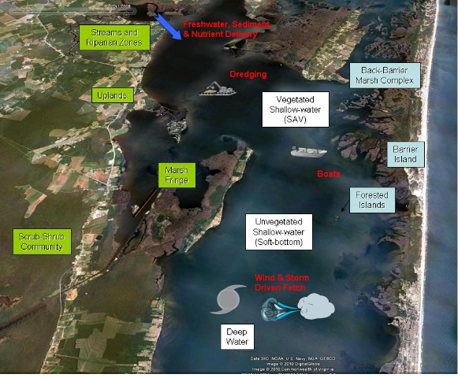
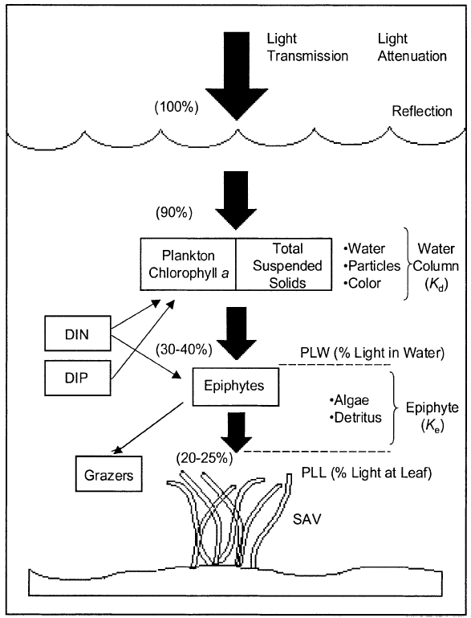
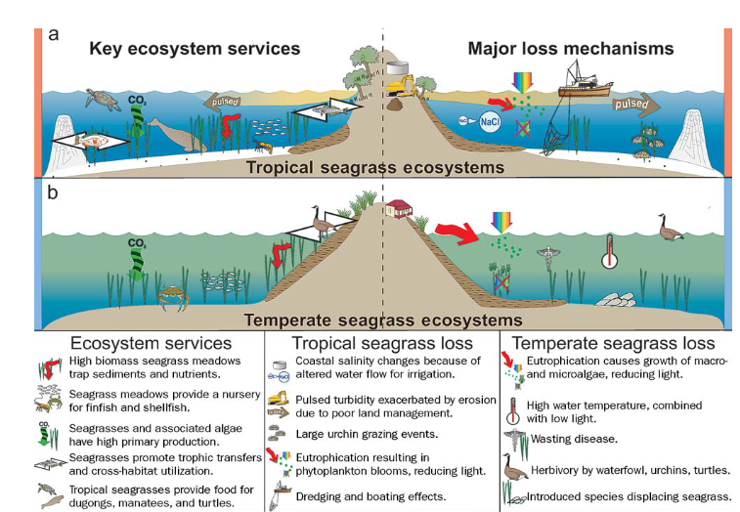
Conceptual Models
Diagramming relationships among components, organizing information, determining data needs

Slide 12
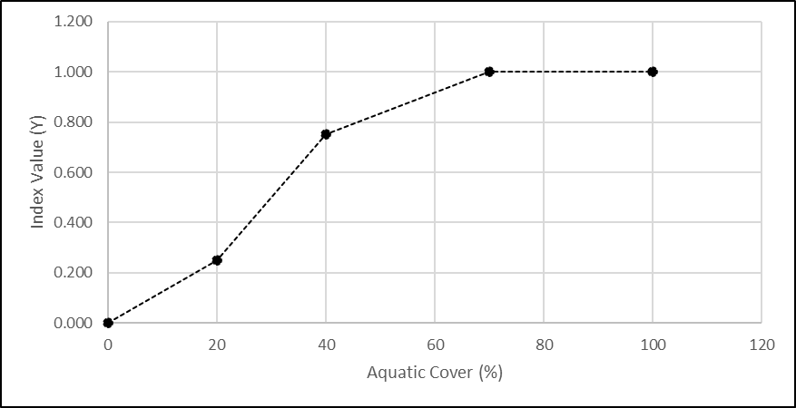
Index Models
Determining ecosystem quality relative to environmental variables
Used by agencies for restoration planning
Simple models based on linear step functions

Slide 13
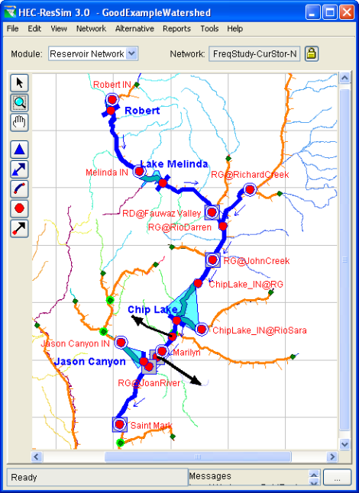
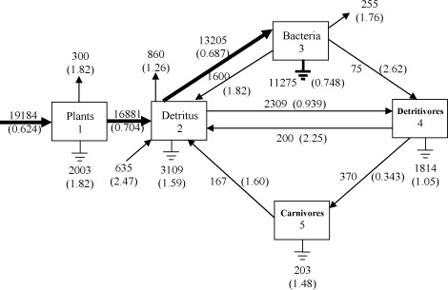
System Dynamics
Modeling dynamics of complex systems by focusing on state of system as summarized variables (e.g., overall biomass, population size, etc)

Slide 14
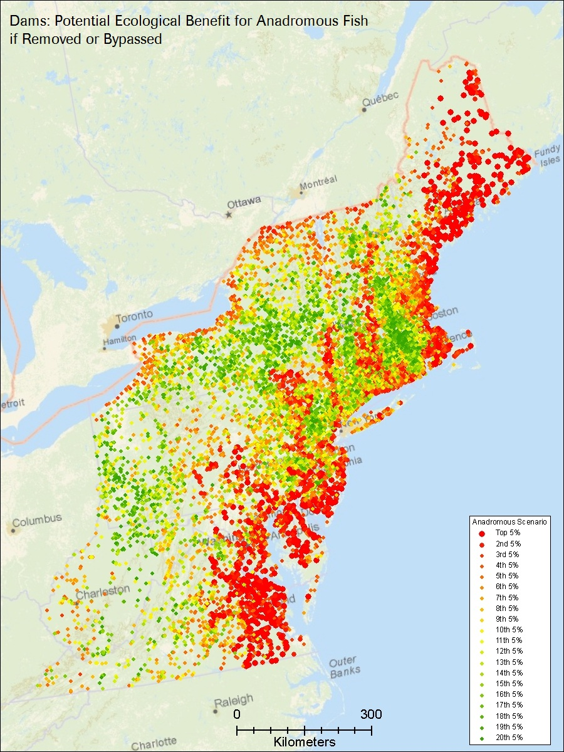
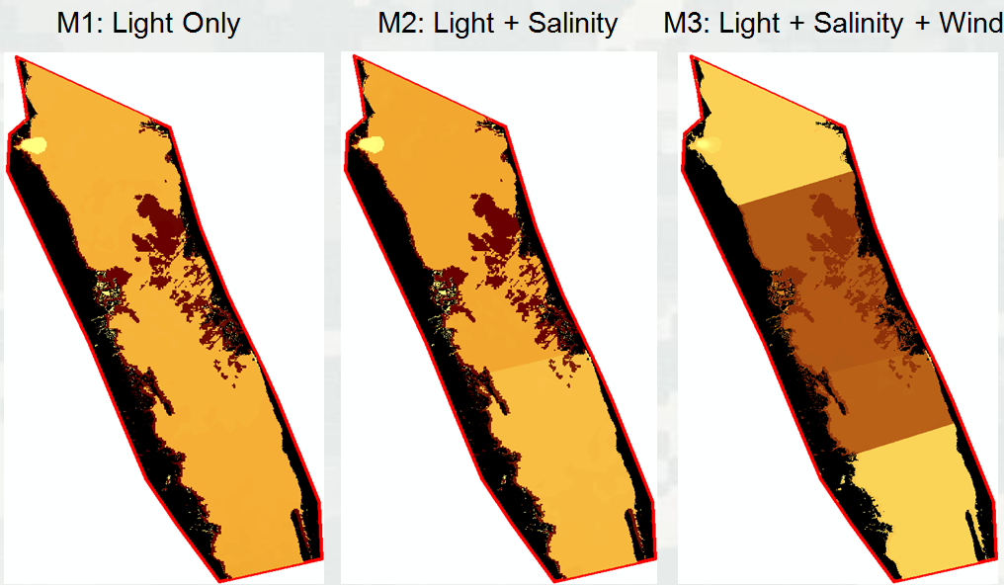
Spatial Models
Combination of spatial attributes often coupled with simulation

Slide 15
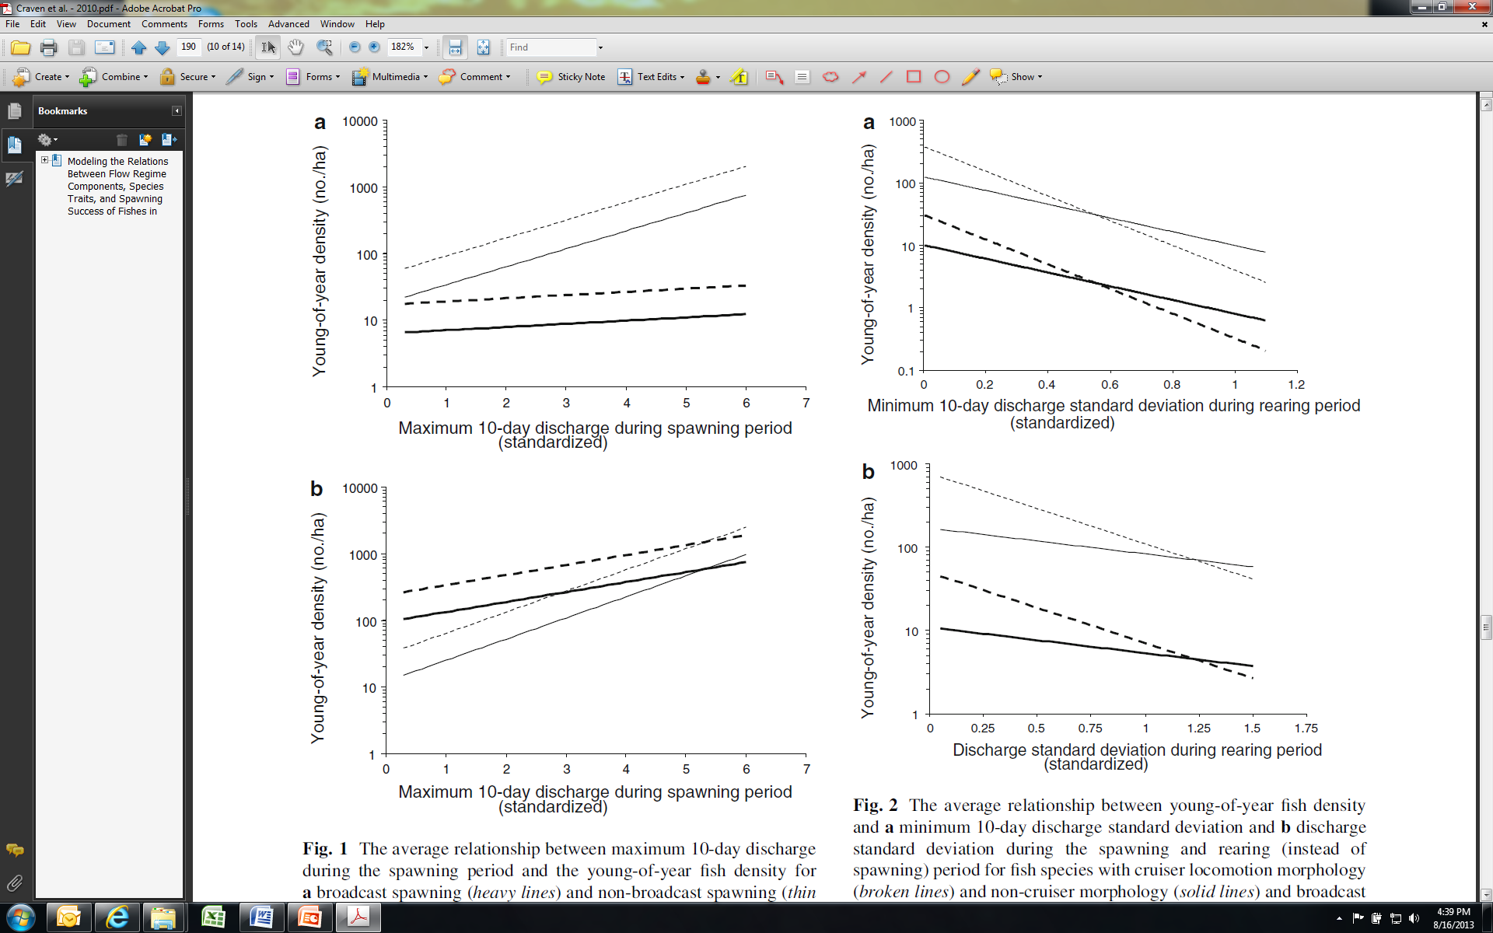
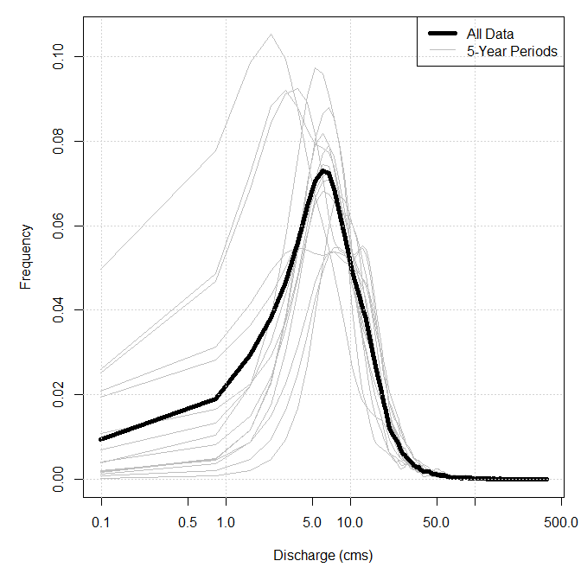
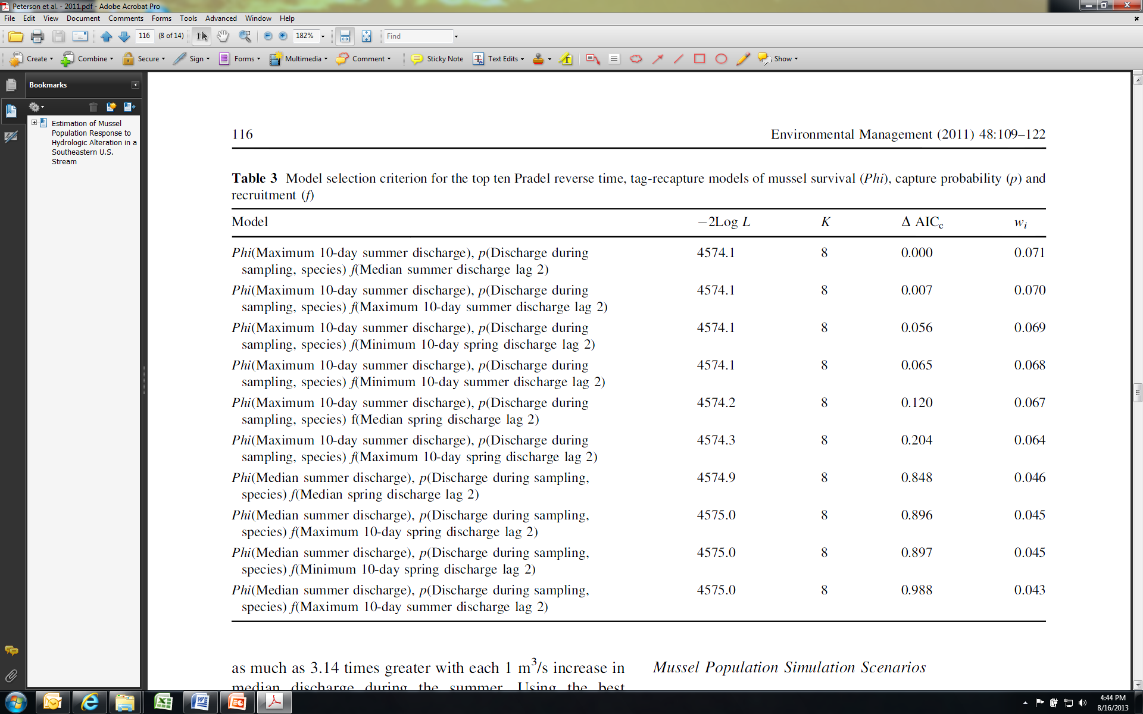
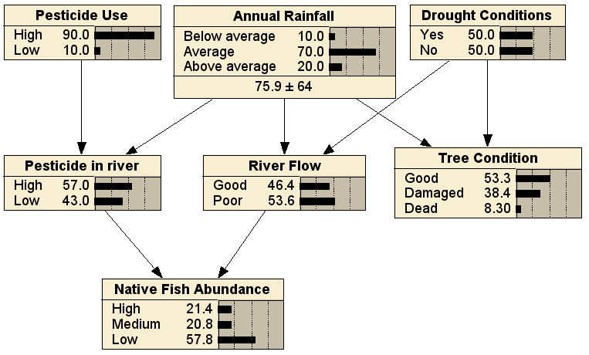
Statistical Models
Analysis of datasets to determine distributional properties of the data
Notes:
Regression
Multi-model
Bayesian
Probability

Slide 16
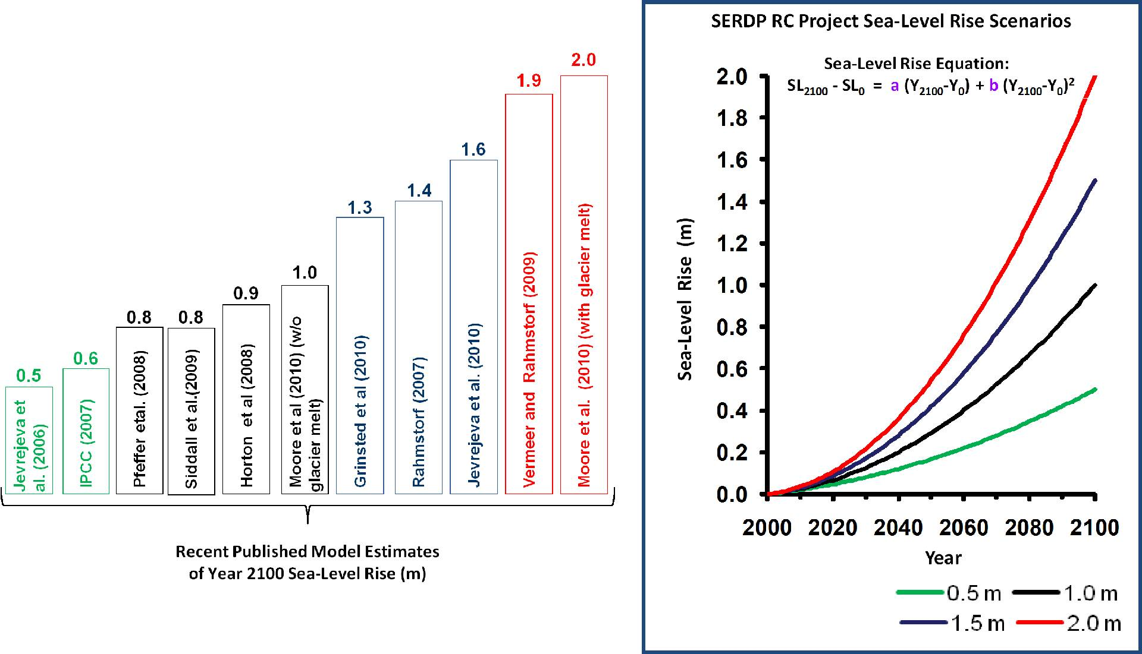
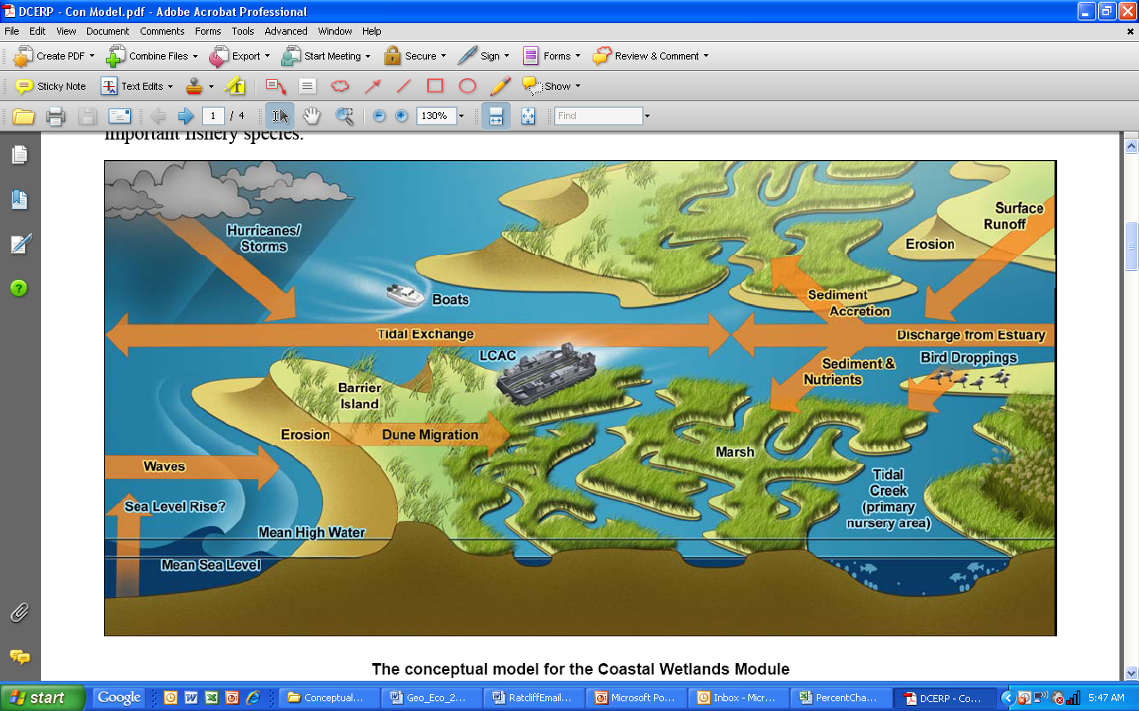
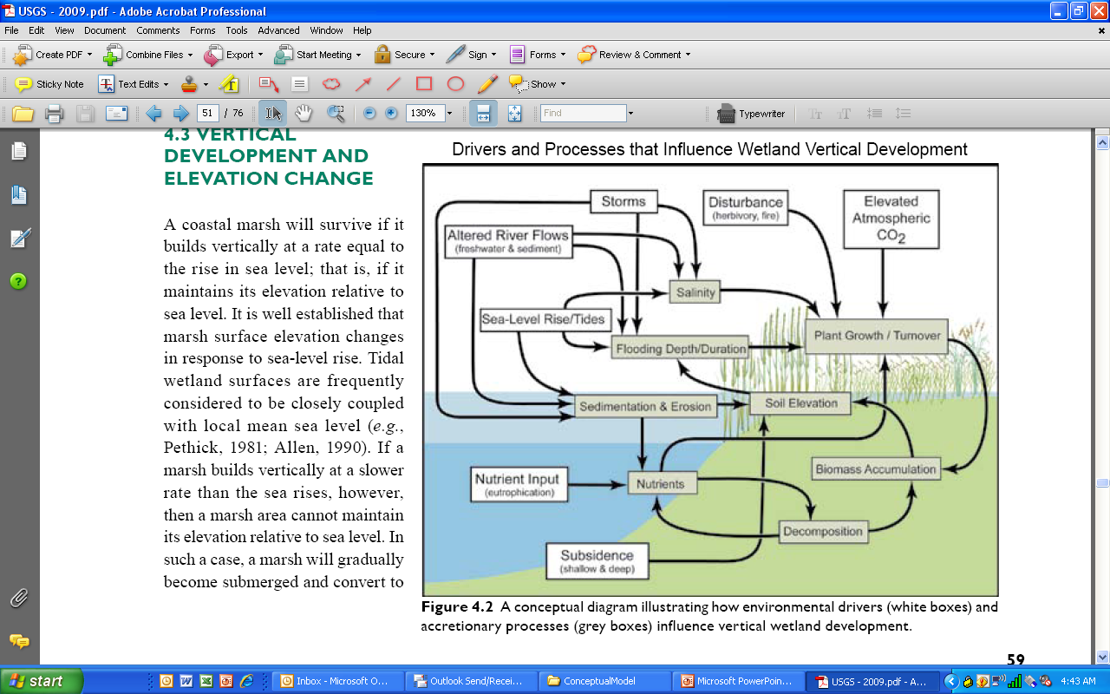
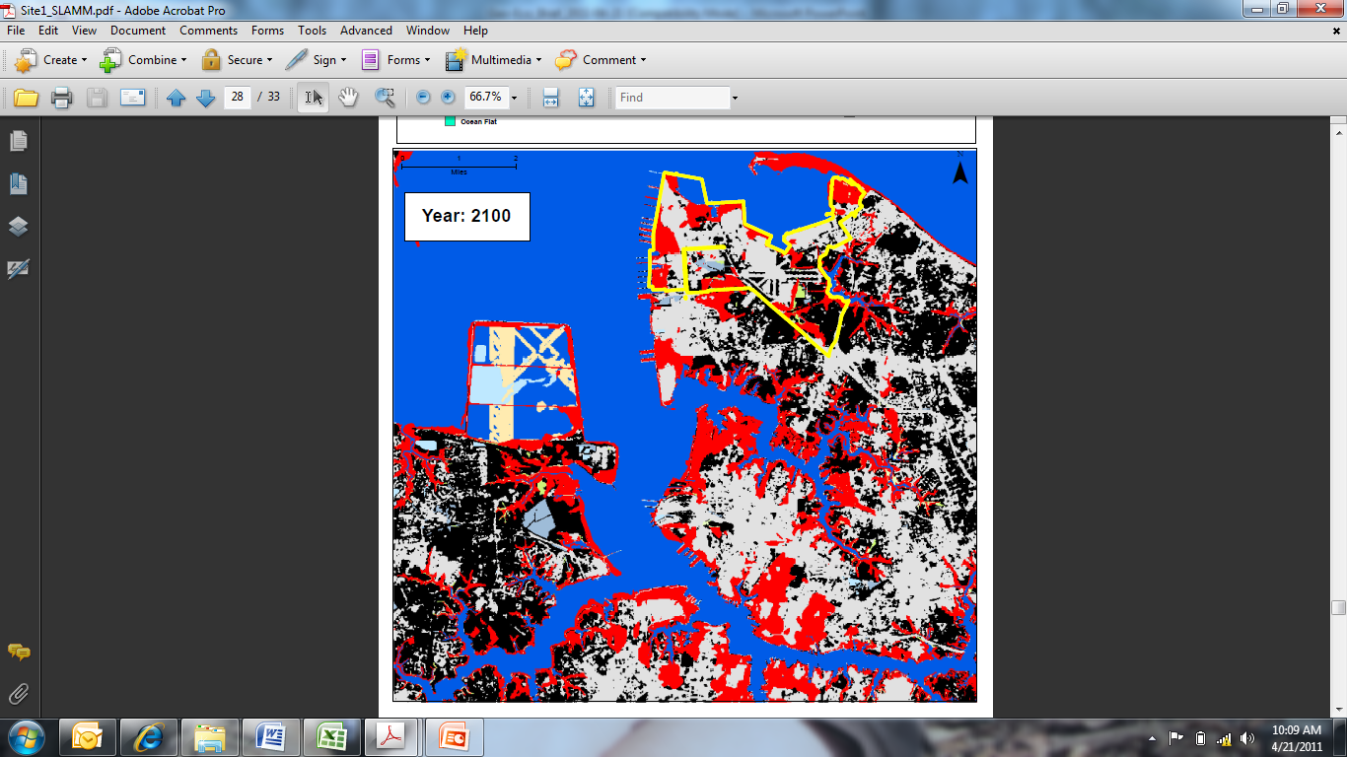
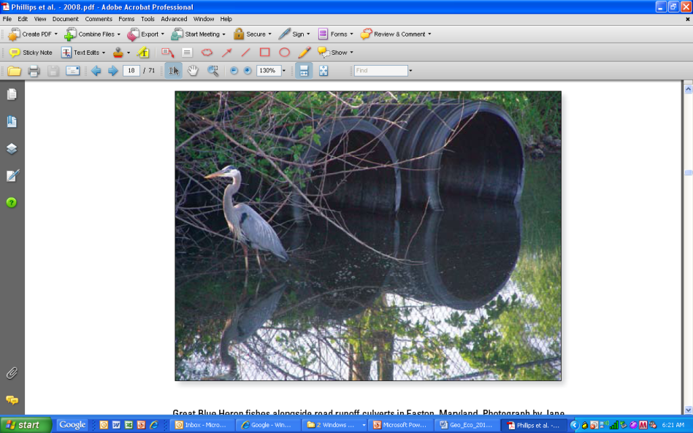
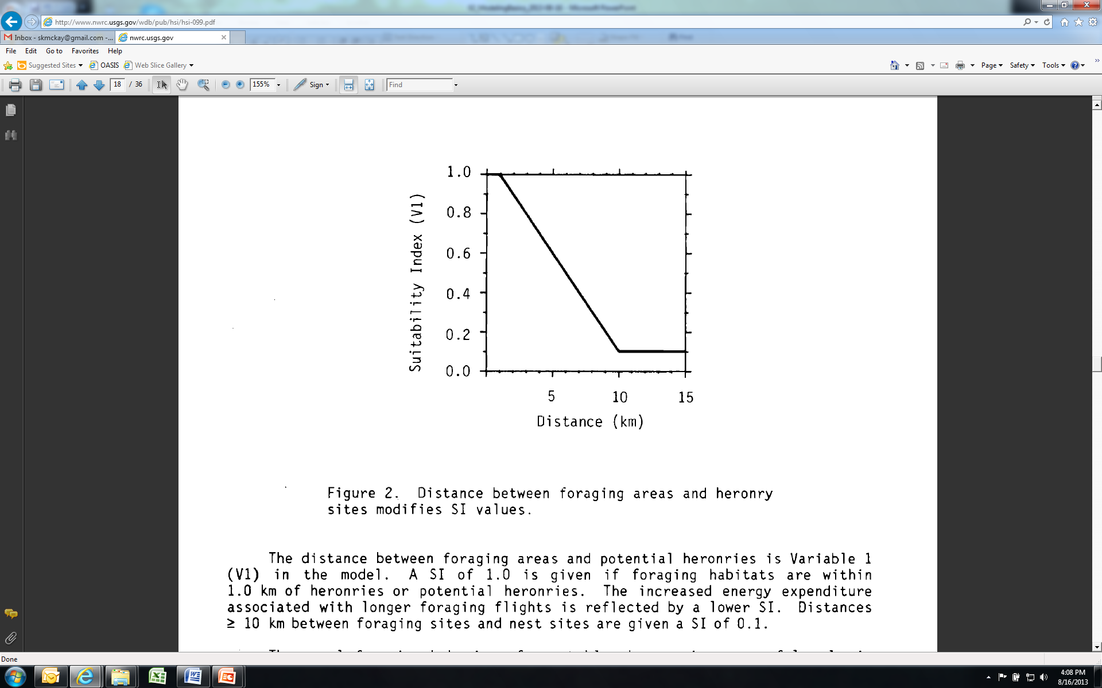
Integrated Modeling

Slide 17
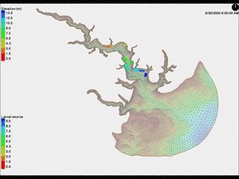
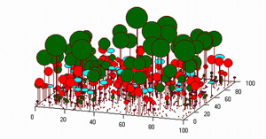
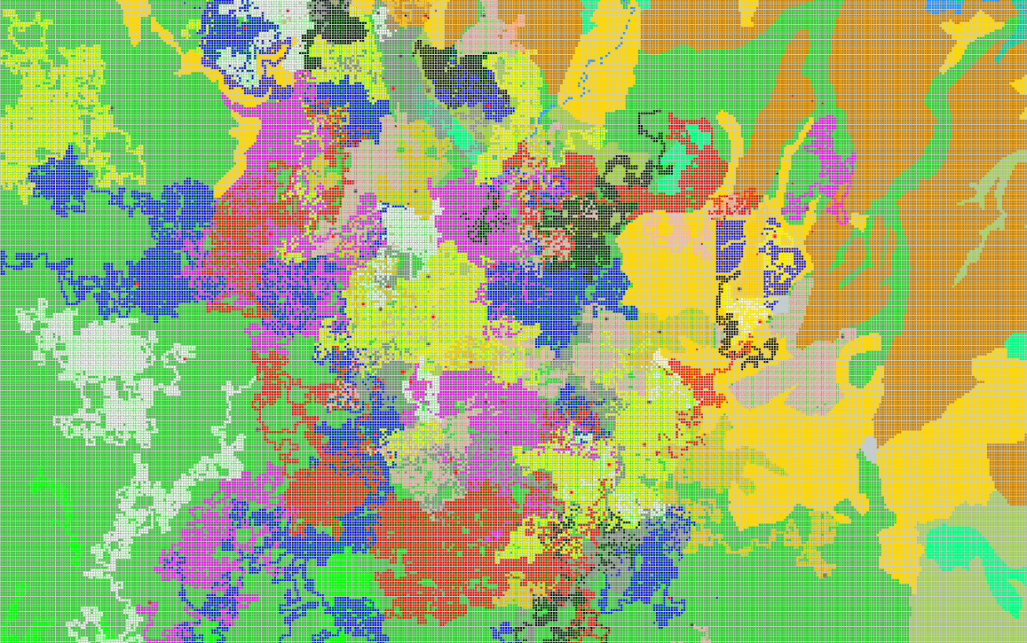
Agent-based Models
Tries to mimic real system by capturing complexity. Builds on concepts of individual interactions creating emergent system properties.
Characteristics
Unique agents are autonomous and interact with others and their environment
System-level properties emerge from low-level behaviors
Different from each other & independent
Model across levels!
Species-Species
Species-Environment

Slide 18
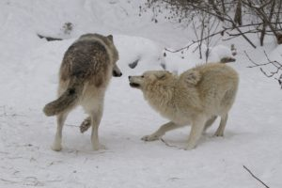
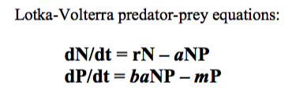
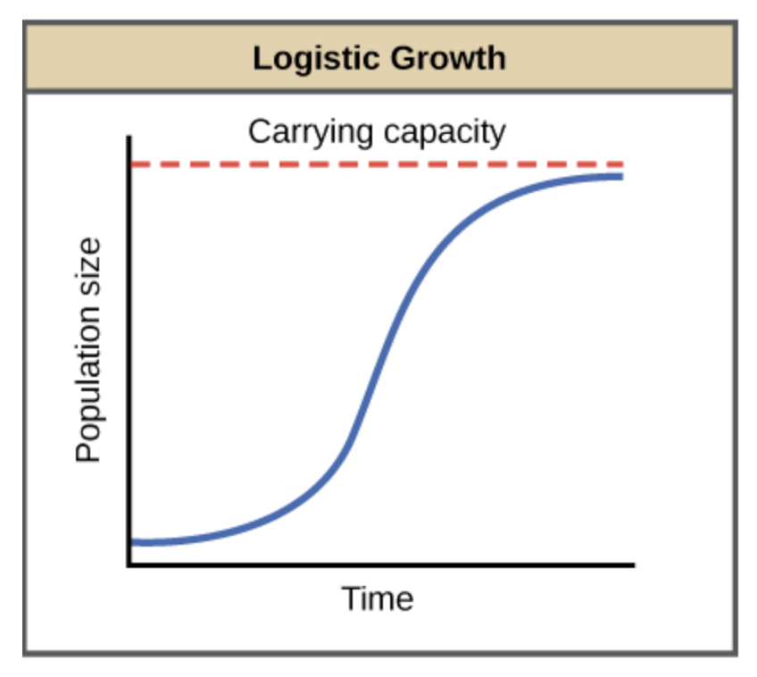
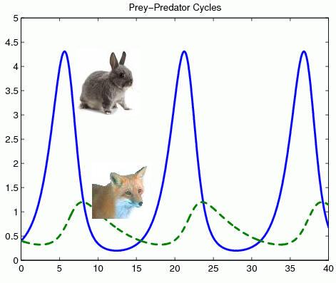
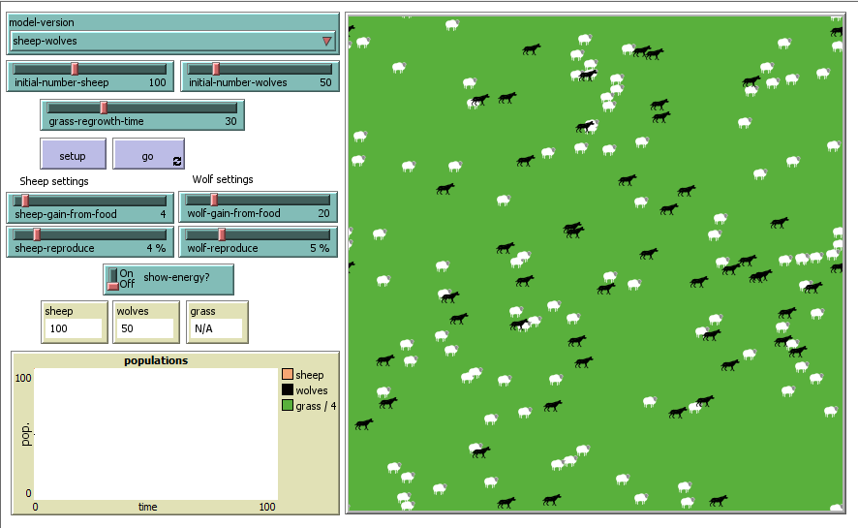


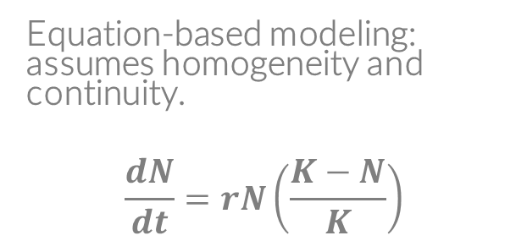


Differences between agent- & equation-based
Equation-based modeling: assumes homogeneity and continuity.
$$\frac{dN}{dt}=rN\left(\frac{K−N}{K}\right)$$
Agent-based: assumes variability and randomness, discrete entities (i.e., can’t have ¼ a wolf)

Slide 19
Why Agent-based Models?
Agent-based models are computationally expensive, require some programming skills, and a completely novel way to analyze them.
So why would we use them?
We think of the world more complexly and consider interactions
Can explore what happens to systems because of individuals, and to individuals because of systems (feedbacks and thresholds)
Can use rules instead of equations to explain phenomena (e.g, don’t have to know differential equations). Language is much closer to natural language.
Enables analysis of big data and integrated approaches.
Notes:
Ecologists are perfect for agent-based modeling. Our job is to study interactions and spend time getting frustrated when nature doesn’t do what we want.

Slide 20
Main uses for ABMs
Description – describes real world system
Explanation – identifies essential mechanisms, explicates mechanisms of emergence
Experimentation – create a virtual laboratory for testing hypotheses
Analogy – relates to other systems/processes
Dialog – focused discussions on what’s most important for generating patterns
Communication/Education – tools for explaining system dynamics
Prediction – forecast system dynamics (depends on accuracy of input data)

Slide 21
Conceptual Overview
Landscape/Animals
Population Dynamics
Dispersal
System
Level
Animal
Natality
Water
Mortality
Habitat Cells
Water
Hab. Quality
# of Ind.
Etc…
Individuals
Gender
Life Stage
Location
Etc…
Individual
Level

Slide 22

Emergence
Arising of novel and coherent structures, patterns and properties though interaction of elements
Can’t be deduced from the properties of the elements
Pattern can feedback on individuals…across levels!
Key is to find simplest ruleset to generate emergent patterns
Example (show model)
Imagine a system of arrows where each faces the same direction along a defined radius of a circle
Assign 1 rule: Each second move forward 0.35 units and then turn right 1°. What will happen?
Scenario 2: They move 0.5 units. What will happen?

Slide 23
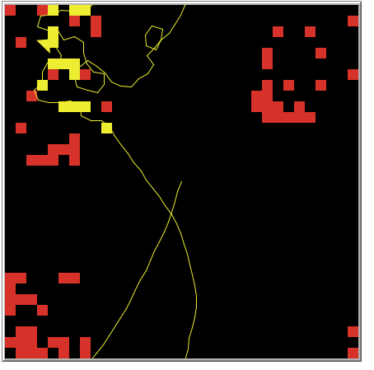
Predator-prey
Adaptive Behavior
Agent-based model

Slide 24
Let’s get it!: Intro to Netlogo
Netlogo
Agent-based modeling platform (designed by Uri Wilensky at MIT & Northwestern), based on Logo language, which was designed to help children think logically (Feurzeig, Solomon, & Papert 1967)
Spatially explicit by nature
Low threshold designed to narrow gap between modeler and programmer
High ceiling—models can be scientific enough to be published in literature.
Open-source and extendable (GIS, R, among others)
NOT CASE-SENSITIVE
Notes:
Ecologists are perfect for agent-based modeling. Our job is to study interactions and spend time getting frustrated when nature doesn’t do what we want.

Slide 25
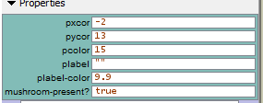
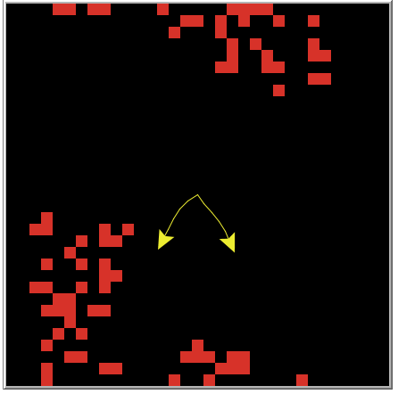
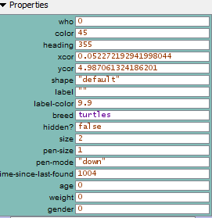
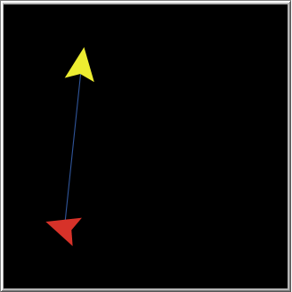
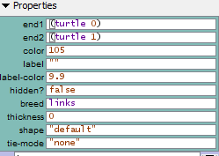
Basics of Netlogo
Patches-own
Turtles-own
Grid-based
Composed of 3 agentsets
Turtles (mobile)
Patches (grid)
Links (relates two or more turtles)
Each agentset can have variables (turtles-own, patches-own). Can be different for each patch/turtle.
Variables can be shared across turtles and patches (globals). Can be modified by any patch and/or turtle.
Links-own

Slide 26

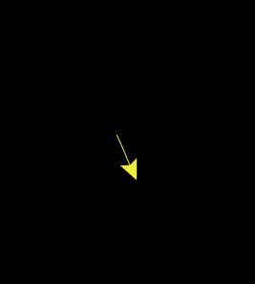

Primitives
Ask patch 0 0
[
Ask neighbors4
[
set pcolor red
]
]
Heart of Netlogo
Built in procedures/functions
Designed to save time programming and get to modeling
Two types
Commands: tell an agent to do something (ask, move, …)
Reporters: calculate a value and report it back to program (sum, mean, …)
Ask turtles
[
fd 3
]
Let total-turtles count turtles
Set total-turtles count turtles

Slide 27


Netlogo dictionary

Slide 28




Procedures
Can write procedures and reporters (i.e., functions) with multiple primitives
to <name>
<commands>
End
to report <name>
<commands>
report X
end

Slide 29

Let’s get to modeling!
Adaptive Behavior – Mushroom Hunt, Ch. 2.
Model objective: Have a turtle exhibit adaptive behavior while searching for patches with mushrooms
1) Check settings
2) Create setup on GUI
3) Create setup procedure

Slide 30




Let’s get to modeling!
Adaptive Behavior – Mushroom Hunt, Ch. 2.
Model objective: Have a turtle exhibit adaptive behavior while searching for patches with mushrooms
4) Create Go and Step
5) Create Go procedure
6) Turn patches red & test

Slide 31



Let’s get to modeling!
Adaptive Behavior – Mushroom Hunt, Ch. 2.
Model objective: Have a turtle exhibit adaptive behavior while searching for patches with mushrooms
In class assignment:
Create two turtles that search the landscape for red patches (i.e., mushrooms).
Follow the example in Ch. 2.
Use the dictionary.
Ask questions!
7) Create clusters of red patches & test
8) Run it again

Slide 32
Primitives used
ask
clear-all (ca)
n-of
in-radius
set/let
size
color/pcolor
reset-ticks
tick
ifelse
right
forward (fd)
random

